Slide 1
Chapter9 Texture
Presenter: Jia-Cheng Lin (林佳城)
Phone: 0958700727
E-Mail: r10922162@csie.ntu.edu.tw
Advisor: Prof. Chiou-Shann Fuh

Slide 2
Outline
Introduction
9.1
Statistical Texture Feature Approach
9.2 ~ 9.10
Model-based Technique
9.11 ~ 9.13
Application
9.16 ~ 9.18

Slide 3
Introduction
Statistical Texture Feature Approach
Model-based Technique
Application

Slide 4
What is “texture” ?

Slide 5
Introduction
What does texture mean?
Formal approach or precise definition of texture does not exist.
Texture discrimination techniques are for the most part ad hoc.
created for a particular purpose only

Slide 6
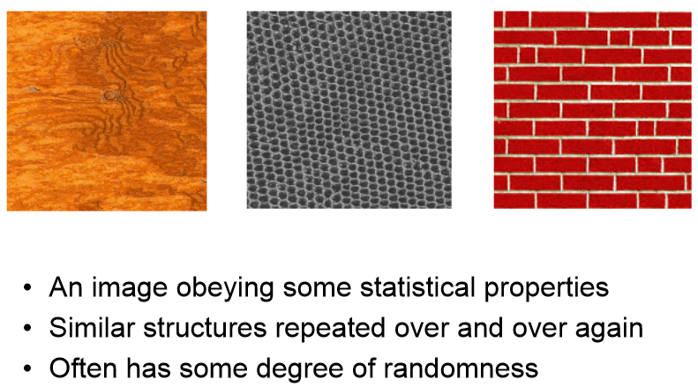
What is Texture?
An image obeying some statistical properties
Similar structure repeated over and over again
Often has some degree of randomness

Slide 7
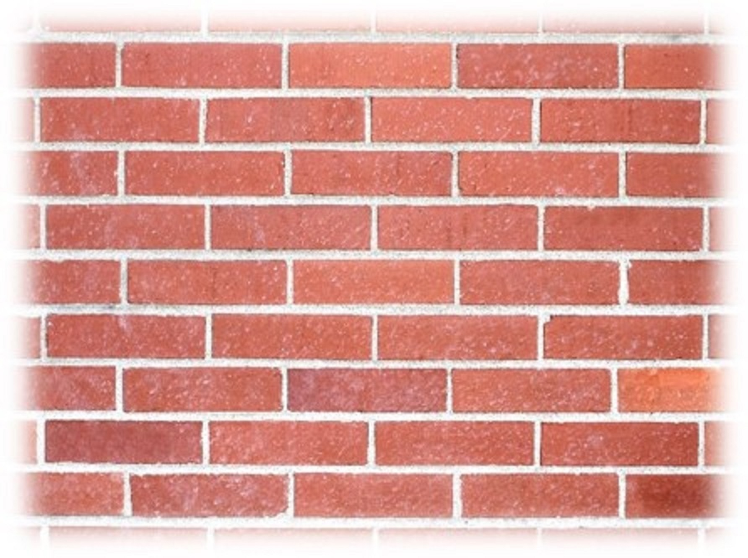
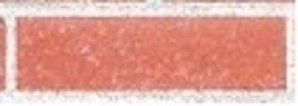
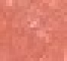
What is Texture?
Texture is a non-local property.
Repeating patterns of local variations in image intensity which are too fine to be distinguished as separated object at the observed resolution.

Slide 8
“Texel” and “Texture Primitive”

Slide 9
Texel
Texture element: basic textural unit of some defining spatial relationships.
Texture: A set texels occurring in some regular or repeated pattern.
Elements | Construct | Array
Pixels |  | Image
Texels |  | Texture

Slide 10
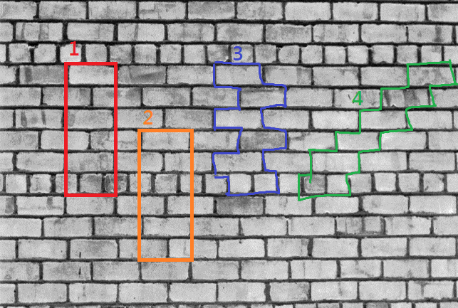
Texel

Slide 11
Texture Primitive
Connected set of pixels characterized by attribute set.
Simplest primitive: pixel with gray level attribute
More complicated primitive: connected set of pixels homogeneous in level, characterized by size, elongation, orientation, and average gray level

Slide 12
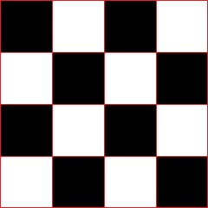
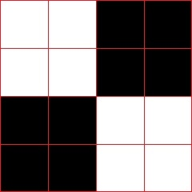
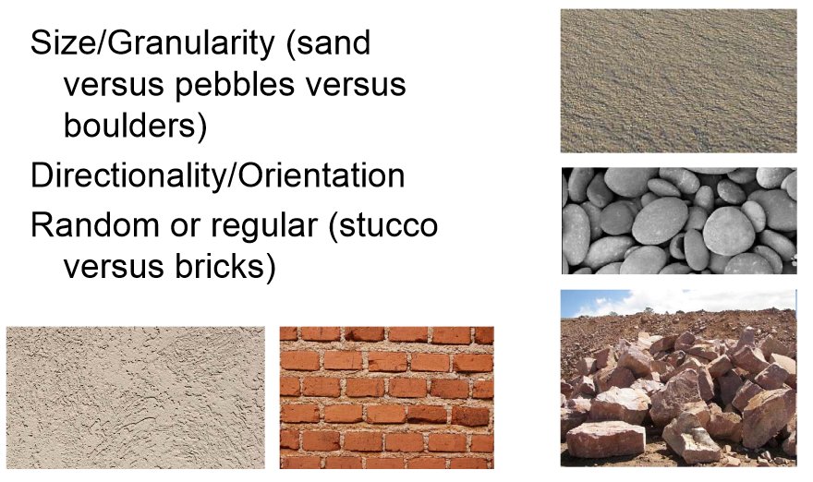
Characterizing Texture
An image texture is described by
types of its primitives
number of its primitives
their spatial organization or layout.
Image texture can be qualitatively evaluated as some properties.

Slide 13
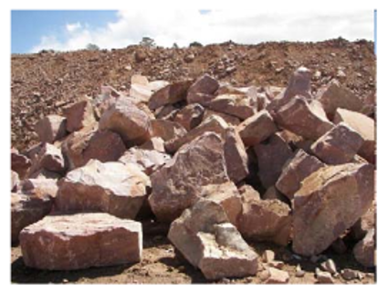
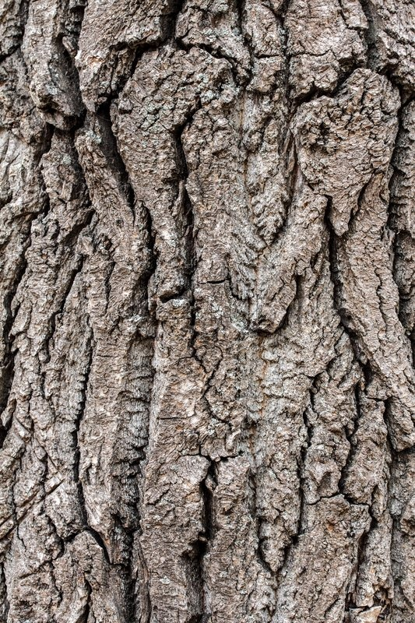
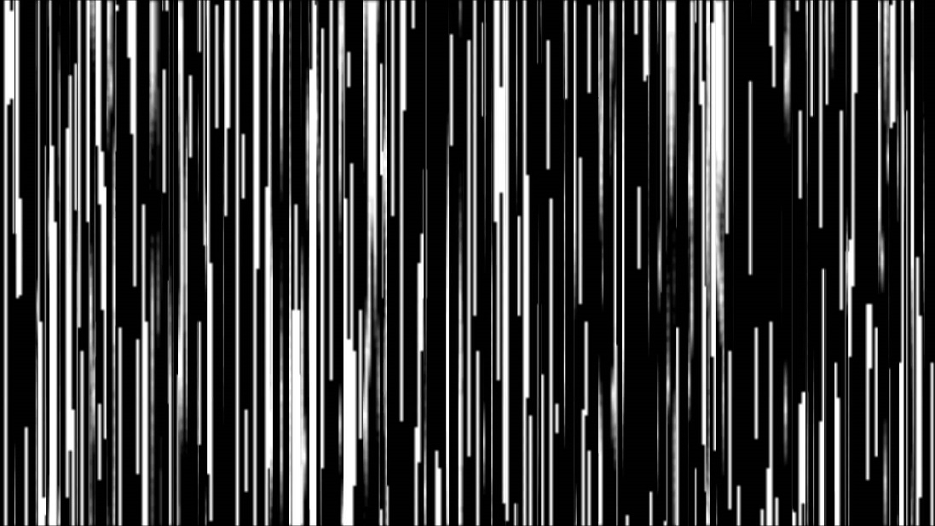
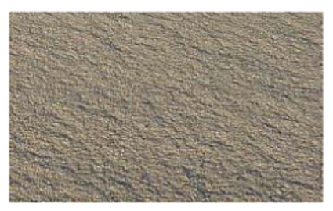
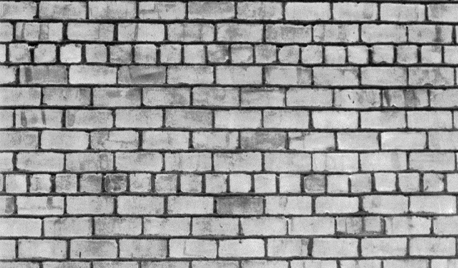
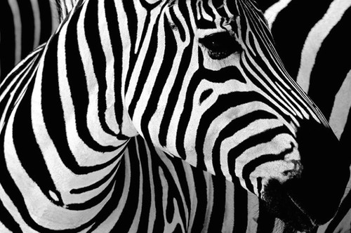
Some Texture Properties
Fineness
Coarseness
Contrast
Directionality
Roughness
Regularity
Smoothness

Slide 14
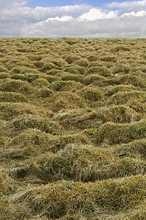
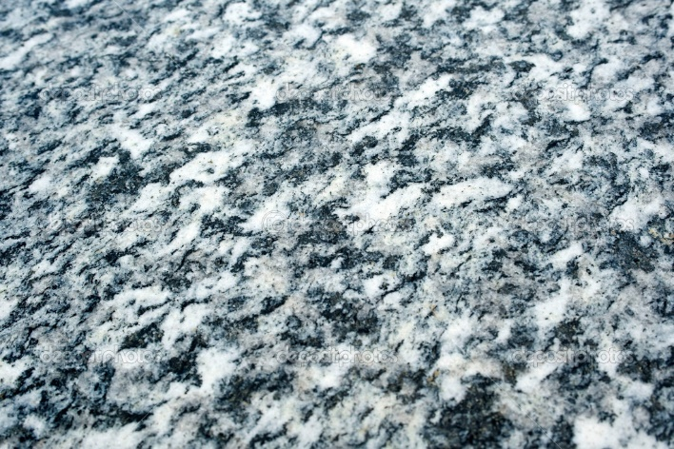
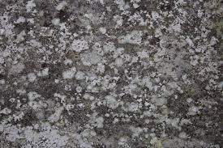
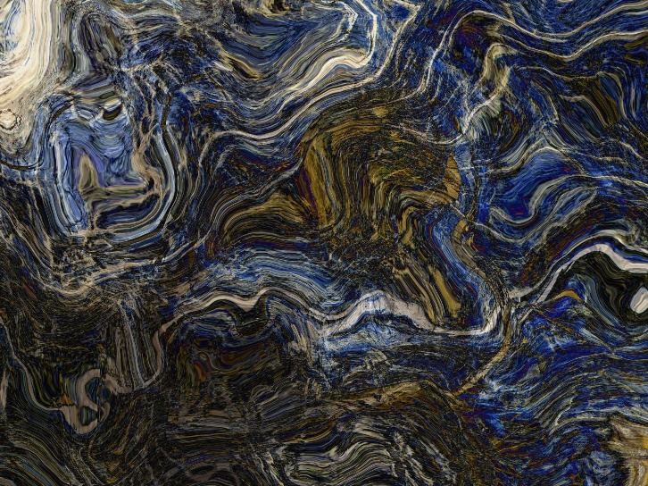
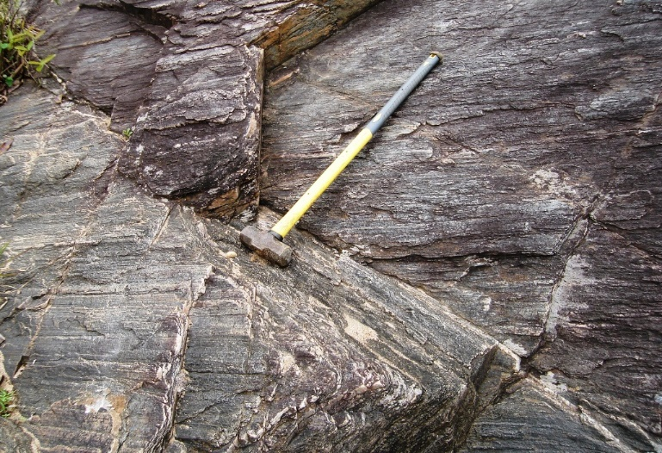
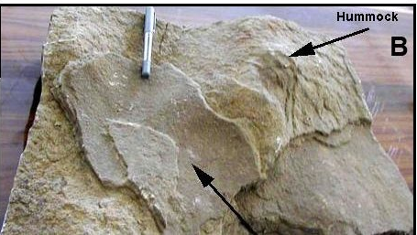
Some Texture Properties
Granularity
Randomness
Lineation
Mottled
Irregular
Hummocky

Slide 15
Characterizing Texture
Each of these qualities translates into some property of the gray level primitives and the spatial interaction between them.
Open issue:
Map semantic meaning into precise properties.
Texture discrimination techniques are for the most part
ad hoc.
created for a particular purpose only

Slide 16
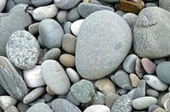
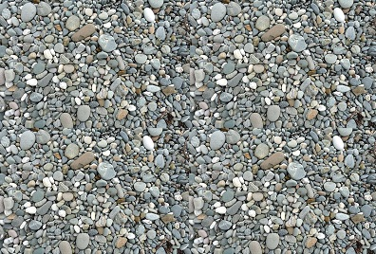
Texture and Scale
Which one is coarse/fine?

Slide 17
Texture and Scale
For any textural surface, there exists a scale at which, it appears smooth and “textureless”. (see from infinite distance)
As resolution increases, the surfaces appears as a fine texture and then a coarse one, and for multiple-scale textural surface the cycle of smooth, fine, and coarse may repeat.
https://www.youtube.com/watch?v=0vnA_KIojLg

Slide 18
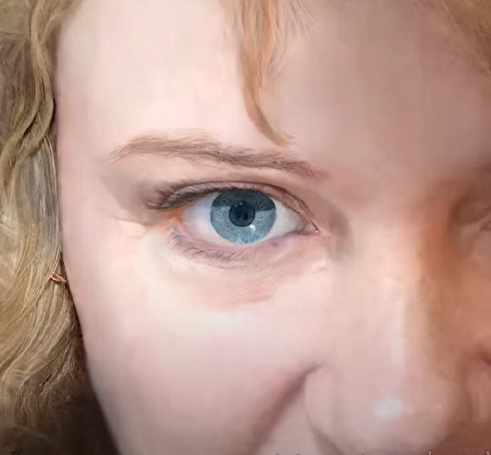
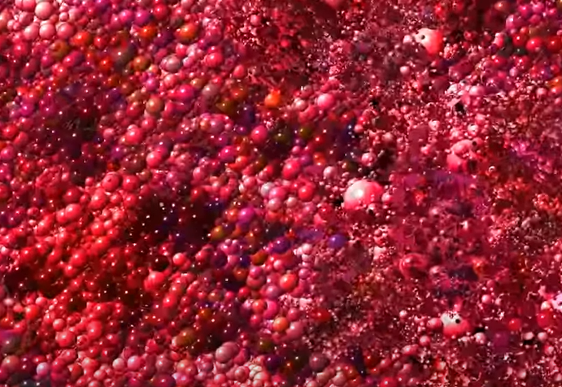
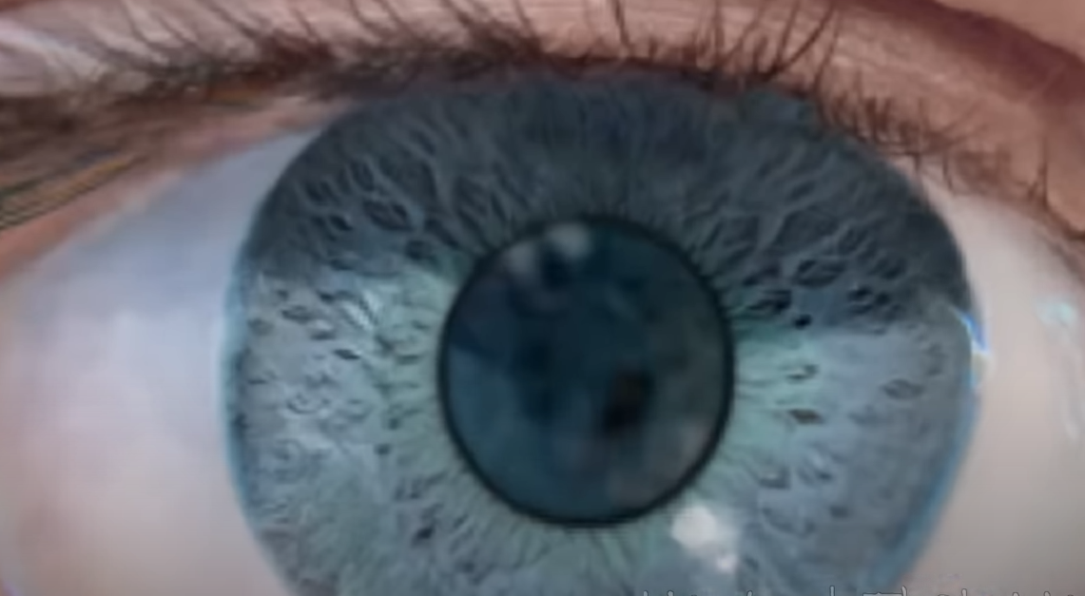
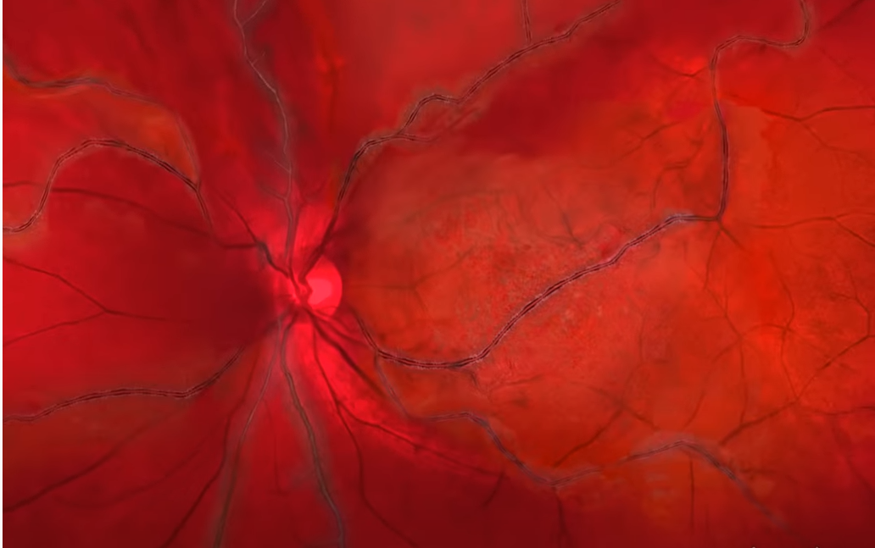
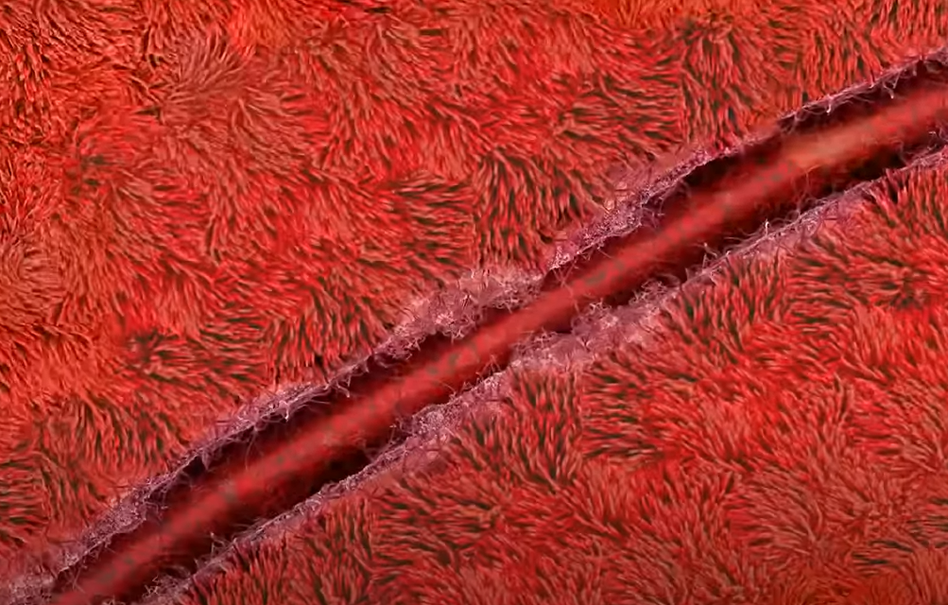
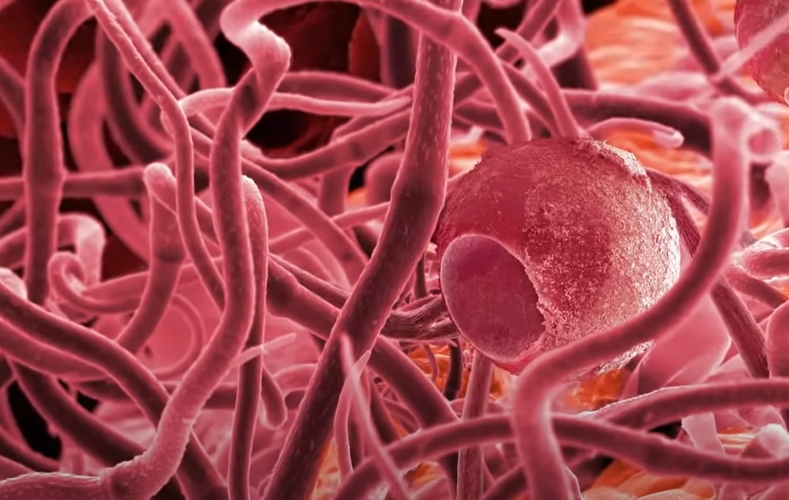
Texture and Scale

Slide 19
Texture and Scale
Texture cannot be analyzed without frame of reference on scale or resolution.
Texture is a scale-dependent phenomenon.

Slide 20
How to Analyze Texture ?

Slide 21
Texture Analysis Issues (Test)
Pattern recognition:
Given textured region, determine the class the region belongs to.
Generative model:
Given textured region, determine a description or model for it.
Texture segmentation:
Given image having many textured areas, determine boundaries.

Slide 22
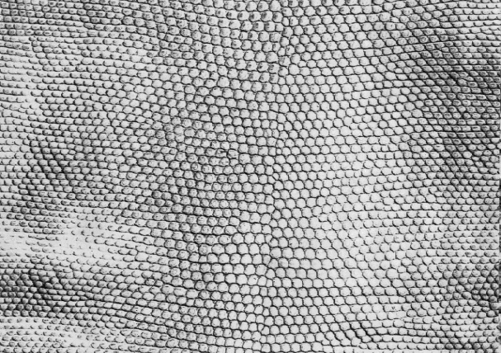
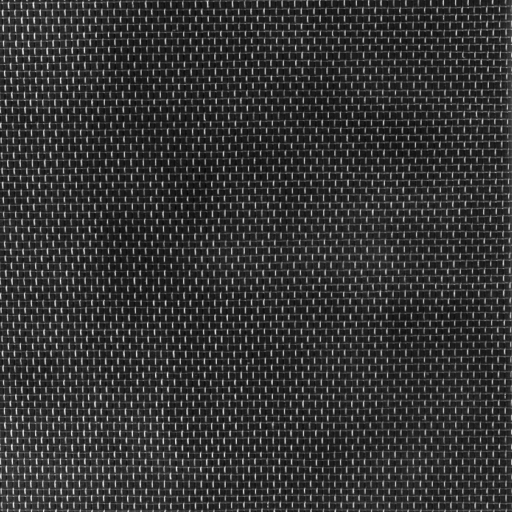

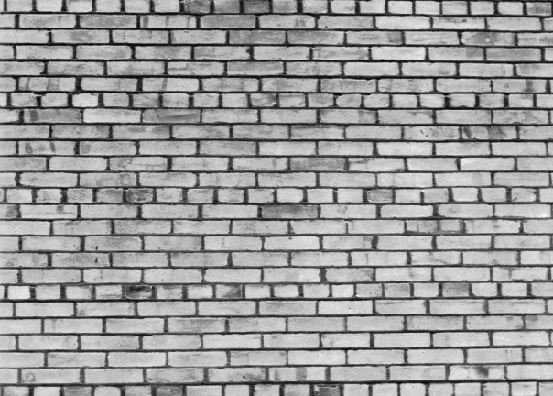
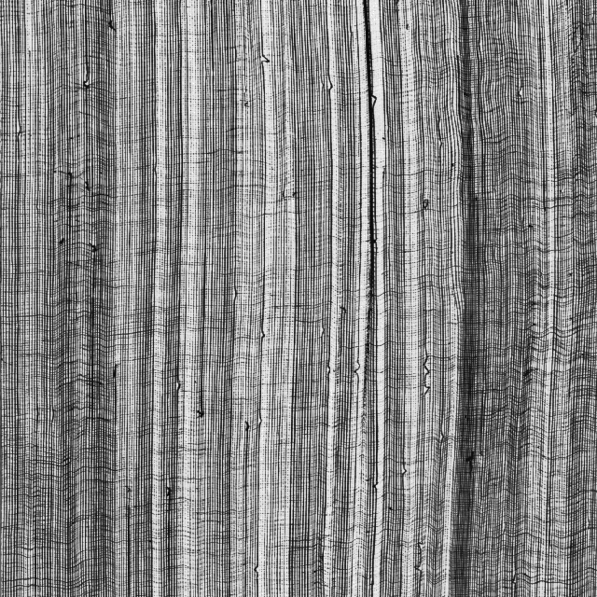
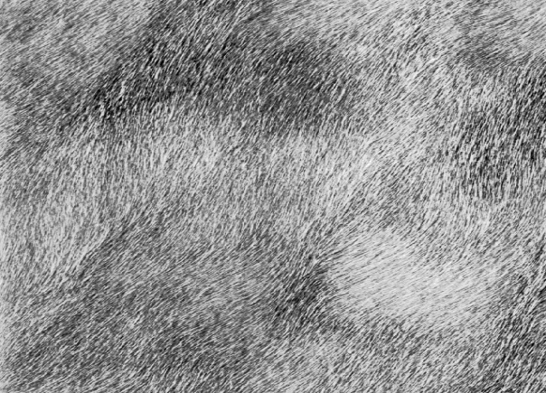
Pattern Recognition
Scales
Linen
Nylon
Bricks
Gauze
Fur
Notes:
鱗片
麻布
尼龍布
磚牆
紗布
毛皮

Slide 23
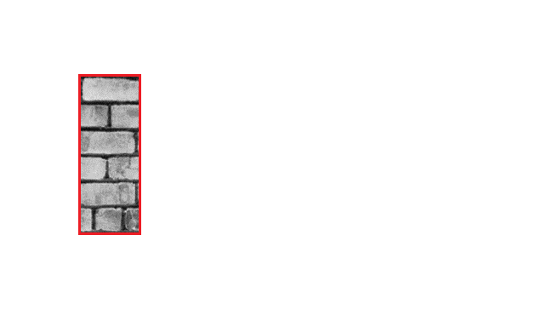
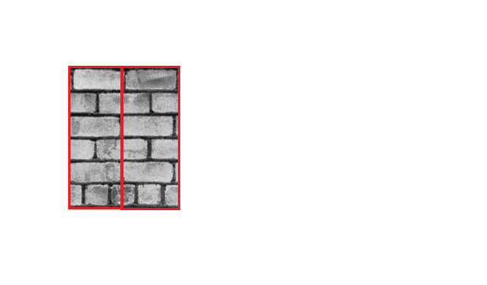
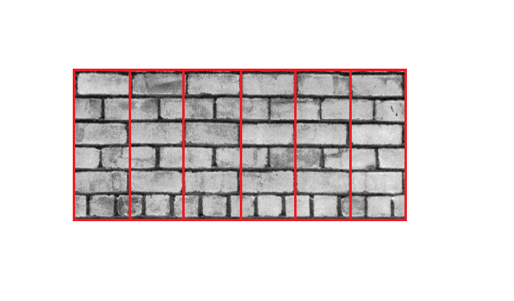
Generative Model

Slide 24
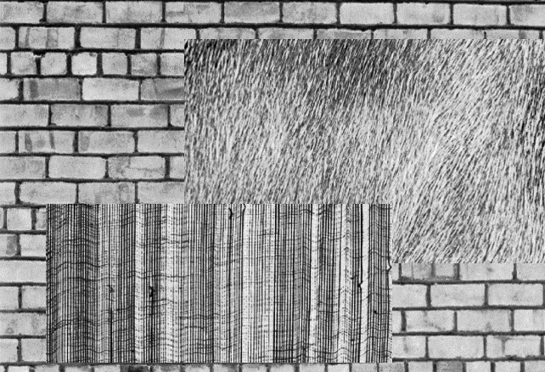
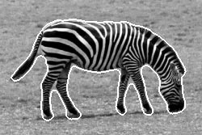
Texture Segmentation

Slide 25
Texture Analysis
Statistical Approach
Model-based Technique

Slide 26
Statistical Texture Feature Approaches
Spatial gray level co-occurrence probabilities
Autocorrelation function
Edgeness per unit area
Relative extrema distributions
Mathematical morphology
Spectral power density function
Gray-level run-length distributions

Slide 27
Model Based Technique
Auto-regression
Markov random fields
Random Mosaic models
Moving-average
Time-series models (extended to 2D)

Slide 28
Statistical Texture Feature Approach

Slide 29
Introduction
Gray Level Statistics
Statistical Texture Feature Approach
Model-based Technique
Application

Slide 30
First-Order Gray-Level Statistics
Statistics of single pixels
E.g. Histogram, mean, median, variance

Slide 31
Second-Order Gray-Level Statistics
The combined statistics of gray levels of pairs of pixels in which each two pixels in a pair have a fixed relative position
E.g. co-occurrence
Gray level spatial dependence: characterize texture by co-occurrence

Slide 32
Co-Occurrence Matrix
The gray level co-occurrence can be specified in a matrix of relative frequencies Pij with which two neighboring pixels separated by distance d occur on the image, one with gray level i and the other with gray level j
Symmetric matrix
Function of angle and distance between pixels

Slide 33
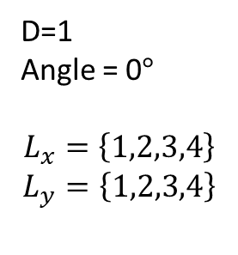
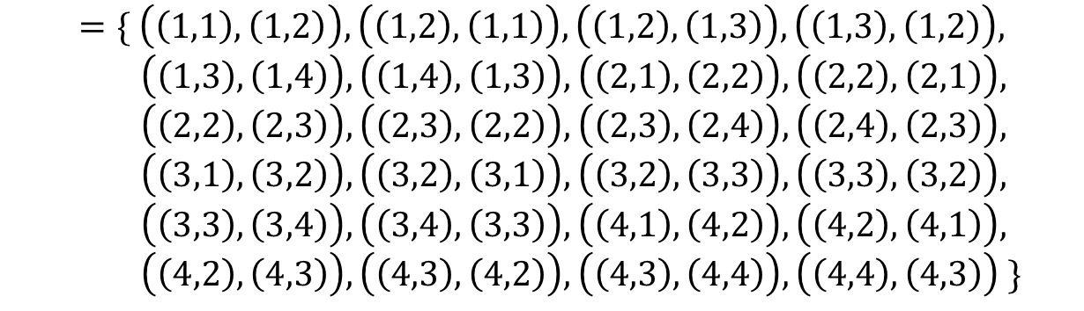
Co-Occurrence Matrix
(1,1) | (1,2) | (1,3) | (1,4)
(2,1) | (2,2) | (2,3) | (2,4)
(3,1) | (3,2) | (3,3) | (3,4)
(4,1) | (4,2) | (4,3) | (4,4)
D=1
Angle = 0$°$
$$L_{x}=\left\{1,2,3,4\right\}$$
$$L_{y}=\left\{1,2,3,4\right\}$$
$$R_{H}=\left\{\left(\left(k,l\right),\left(m,n\right)\right)∈\left(L_{y}×L_{x}\right) \right| k−m=0,\left|l−n\right|=1\}$$
$$=\{ \left(\left(1,1\right),\left(1,2\right)\right),\left(\left(1,2\right),\left(1,1\right)\right),\left(\left(1,2\right),\left(1,3\right)\right),\left(\left(1,3\right),\left(1,2\right)\right),$$
$\left(\left(1,3\right),\left(1,4\right)\right),\left(\left(1,4\right),\left(1,3\right)\right),\left(\left(2,1\right),\left(2,2\right)\right),\left(\left(2,2\right),\left(2,1\right)\right),$
$\left(\left(2,2\right),\left(2,3\right)\right),\left(\left(2,3\right),\left(2,2\right)\right),\left(\left(2,3\right),\left(2,4\right)\right),\left(\left(2,4\right),\left(2,3\right)\right),$
$\left(\left(3,1\right),\left(3,2\right)\right),\left(\left(3,2\right),\left(3,1\right)\right),\left(\left(3,2\right),\left(3,3\right)\right),\left(\left(3,3\right),\left(3,2\right)\right),$
$\left(\left(3,3\right),\left(3,4\right)\right),\left(\left(3,4\right),\left(3,3\right)\right),\left(\left(4,1\right),\left(4,2\right)\right),\left(\left(4,2\right),\left(4,1\right)\right),$
$\left(\left(4,2\right),\left(4,3\right)\right),\left(\left(4,3\right),\left(4,2\right)\right),\left(\left(4,3\right),\left(4,4\right)\right),\left(\left(4,4\right),\left(4,3\right)\right) \}$
The set of all distance-1 horizontal neighbor resolution cells on a 4x4 image.

Slide 34
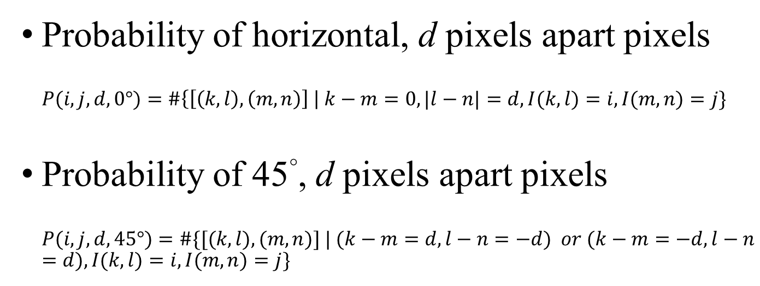
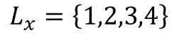
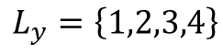
Co-Occurrence Matrix
(1,1) | (1,2) | (1,3) | (1,4)
(2,1) | (2,2) | (2,3) | (2,4)
(3,1) | (3,2) | (3,3) | (3,4)
(4,1) | (4,2) | (4,3) | (4,4)
$$L_{x}=\left\{1,2,3,4\right\}$$
$$L_{y}=\left\{1,2,3,4\right\}$$
Probability of horizontal, d pixels apart pixels
$$P(i,j,d, 0°)=\#\left\{\left[\left(k, l\right),\left(m, n\right)\right] \right| k−m=0, |l−n|=d, I(k, l)=i, I(m,n)=j\}$$
Probability of 45°, d pixels apart pixels
$$P(i, j, d, 45°)=\#\{[(k, l), (m, n)] | (k−m=d, l−n=−d) or (k−m=−d, l−n=d), I(k, l)=i, I(m,n)=j\}$$

Slide 35
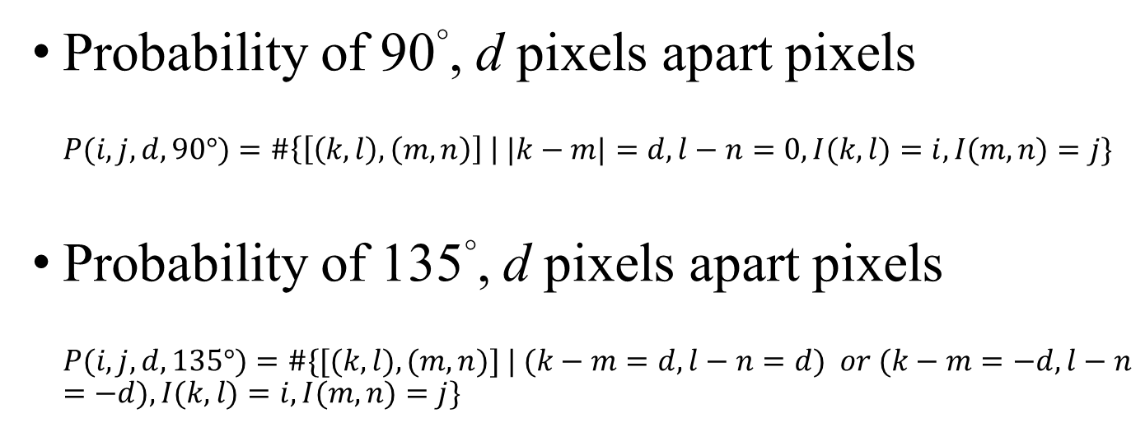
Co-Occurrence Matrix
(1,1) | (1,2) | (1,3) | (1,4)
(2,1) | (2,2) | (2,3) | (2,4)
(3,1) | (3,2) | (3,3) | (3,4)
(4,1) | (4,2) | (4,3) | (4,4)
$$L_{x}=\left\{1,2,3,4\right\}$$
$$L_{y}=\left\{1,2,3,4\right\}$$
Probability of 90°, d pixels apart pixels
$$P(i,j,d, 90°)=\#\left\{\left[\left(k, l\right),\left(m, n\right)\right] \right| |k−m|=d, l−n=0, I(k, l)=i, I(m,n)=j\}$$
Probability of 135°, d pixels apart pixels
$$P(i, j, d, 135°)=\#\{[(k, l), (m, n)] | (k−m=d, l−n=d) or (k−m=−d, l−n=−d), I(k, l)=i, I(m,n)=j\}$$

Slide 36
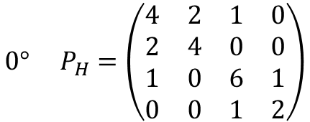
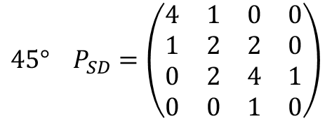
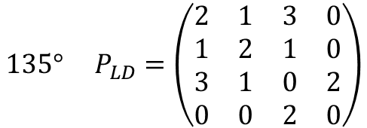
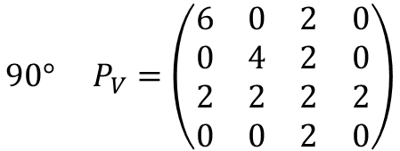
Co-Occurrence Matrix
 |  | Gray level
Gray Level |  | 0 | 1 | 2 | 3
 | 0 | #(0,0) | #(0,1) | #(0,2) | #(0,3)
 | 1 | #(1,0) | #(1,1) | #(1,2) | #(1,3)
 | 2 | #(2,0) | #(2,1) | #(2,2) | #(2,3)
 | 3 | #(3,0) | #(3,1) | #(3,2) | #(3,3)
0 | 0 | 1 | 1
0 | 0 | 1 | 1
0 | 2 | 2 | 2
2 | 2 | 3 | 3
$$0° P_{H}=\left(\begin{matrix}4 & 2 & 1 & 0 \\ 2 & 4 & 0 & 0 \\ 1 & 0 & 6 & 1 \\ 0 & 0 & 1 & 2\end{matrix}\right)$$
$$90° P_{V}=\left(\begin{matrix}6 & 0 & 2 & 0 \\ 0 & 4 & 2 & 0 \\ 2 & 2 & 2 & 2 \\ 0 & 0 & 2 & 0\end{matrix}\right)$$
$$135° P_{LD}=\left(\begin{matrix}2 & 1 & 3 & 0 \\ 1 & 2 & 1 & 0 \\ 3 & 1 & 0 & 2 \\ 0 & 0 & 2 & 0\end{matrix}\right)$$
$$45° P_{SD}=\left(\begin{matrix}4 & 1 & 0 & 0 \\ 1 & 2 & 2 & 0 \\ 0 & 2 & 4 & 1 \\ 0 & 0 & 1 & 0\end{matrix}\right)$$

Slide 37
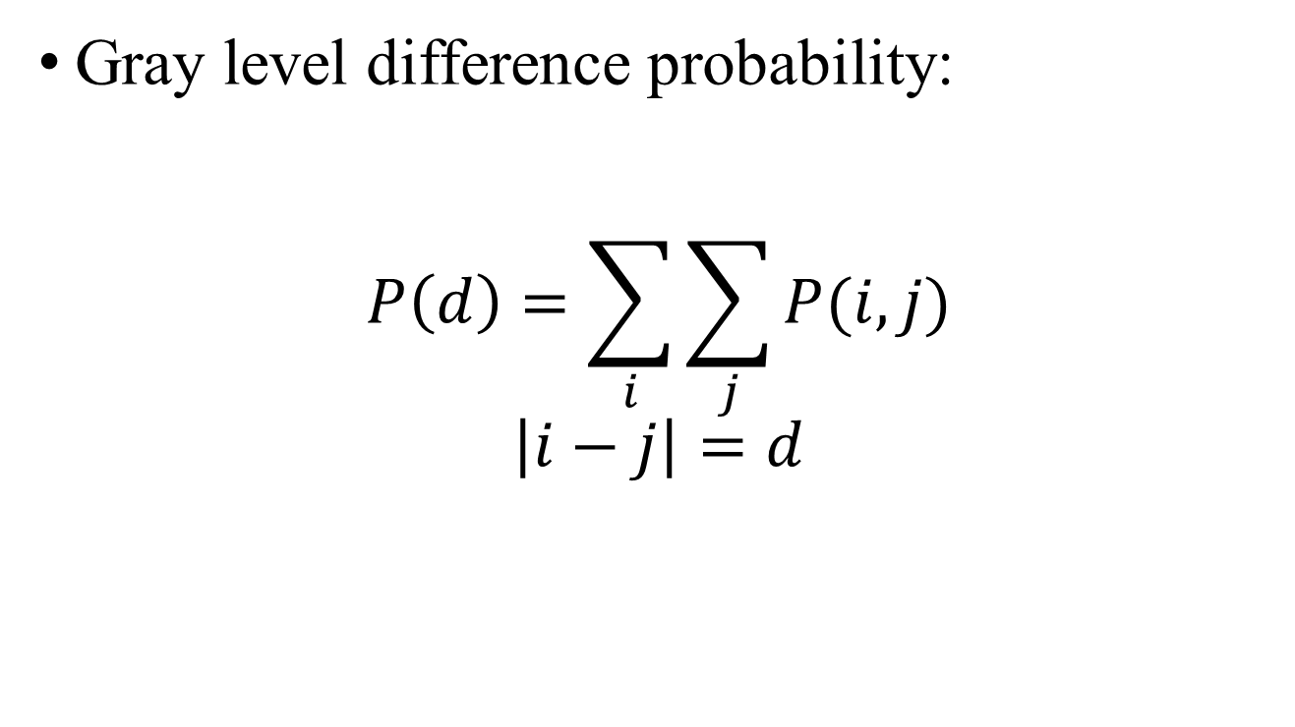
Variant of Co-Occurrence Matrix
Gray level difference probability:
$$P\left(d\right)=\sum_{i}{\sum_{j}{P(i,j)}}$$
$$\left|i−j\right|=d$$

Slide 38
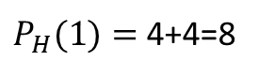






$$0° P_{H}=\left(\begin{matrix}8 & 4 \\ 4 & 8\end{matrix}\right)$$
$$0° P_{H}=\left(\begin{matrix}0 & 12 \\ 12 & 0\end{matrix}\right)$$
$$P\left(d\right)=\sum_{i}{\sum_{j}{P(i,j)}}$$
$$\left|i−j\right|=d$$
$P_{H}(0)=$ 8+8=16
$P_{H}(0)=$ 0+0=0
$P_{H}(1)=$ 4+4=8
$P_{H}(1)=$ 12+12=24

Slide 39





coarse
fine
$$P\left(d\right)=\sum_{i}{\sum_{j}{P(i,j)}}$$
$$\left|i−j\right|=d$$
$P_{H}(0)=$ 8+8=16
$P_{H}(0)=$ 0+0=0
$P_{H}(1)=$ 4+4=8
$P_{H}(1)=$ 12+12=24
The probability of small contrast d for a coarse texture will be much higher than for a fine texture.

Slide 40
Summary of Gray-level Co-Occurrence
Advantages
Use spatial interrelationship of the gray levels to characterize a texture.
Be able to do so by gray-level transformation, which is an invariant way.
Weakness
Not capture the shape aspects of the gray level primitives.
Not likely to work well for textures composed of large-area primitives.
Cannot capture the spatial relationships between primitives that are regions larger than a pixel.

Slide 41
Strong Texture Measures and Generalized Co-occurrence
Gray Level Co-occurrence
Statistical Texture Feature Approach
Model-based Technique
Application

Slide 42
Strong Texture Measures and Generalized Co-occurrence
Strong texture measure takes into account the co-occurrence between texture primitives rather than pixels.
It is useful to work with primitives that are maximally connected sets of pixels having particular properties.
聯集

Slide 43
Strong Texture Measures and Generalized Co-occurrence
Other attributes include measures of shape, or with the variance of its local property.
Connected components
Ascending\descending components
Saddle components
Relative maxima\minima components
Central Axis components
Examples of primitives property

Slide 44
Spatial Relationship
After constructing the primitives, we have
a list of primitives
their center coordinates
their attributes

Slide 45

Spatial Relationship
Generalized co-occurrence matrix P
$Q$ : set of all primitives on the image
$T$ : set of primitive properties
$f$ : function assigning to each primitive in $Q$ a property of T
$S⊆Q×Q$ : binary relation satisfying spatial relationship
$t_{1},t_{2}$ : properties which primitives have
$$f:Q→T$$
$$P\left(t_{1},t_{2}\right)=\frac{\#\{(q_{1},q_{2})∈S|f\left(q_{1}\right)=t_{1}and f\left(q_{2}\right)=t_{2}\}}{\#S}$$

Slide 46
Strong Texture Measures and Generalized Co-occurrence
Autocorrelation Function
Statistical Texture Feature Approach
Model-based Technique
Application

Slide 47
Autocorrelation Function
Texture relates to the spatial size of the gray level primitives on an image
Gray level primitives of larger size are indicative of coarser texture
Gray level primitives of smaller size are indicative of finer texture
Autocorrelation function is a feature that describes the size of gray level primitives

Slide 48





Autocorrelation Function
Area under $f(τ)⋆f(t)$
$$f(τ)$$
$$f(t)$$
($f+f)(t)$

Slide 49

Autocorrelation Function
Autocorrelation function:
$$p\left(x,y\right)=\frac{\frac{1}{\left(L_{x}−\left|x\right|\right)\left(L_{y}−\left|y\right|\right)}\int_{−∞}^{∞}{\int_{−∞}^{∞}{I\left(u,v\right)I\left(u+x,v+y\right)dudv}}}{\frac{1}{L_{x}L_{y}}\int_{−∞}^{∞}{\int_{−∞}^{∞}{I^{2}\left(u,v\right)dudv}}}$$
$$\left|x\right|<L_{x},\left|y\right|<L_{y}$$
Autocorrelation function $p[k,l]$ for $N×N$ image:
$$p[k,l]=\frac{\frac{1}{\left(N−k\right)\left(N−l\right)}\sum_{i=1}^{(N−k)}{\sum_{j=1}^{(N−l)}{f\left[i,j\right]f[i+k,j+l]}}}{\frac{1}{N^{2}}\sum_{i=1}^{N}{\sum_{j=1}^{N}{f^{2}[i,j]}}}$$
$$0≤k,l≤N−1$$

Slide 50












$$p[k]=\frac{\frac{1}{\left(N−k\right)}\sum_{i=1}^{(N−k)}{f\left[i\right]f[i+k]}}{\frac{1}{N}\sum_{i=1}^{N}{f^{2}[i]}}$$
$k=0$
$$\frac{\frac{1}{8}×4}{\frac{1}{8}×4}=1$$
$k=4$
$$\frac{\frac{1}{4}×2}{\frac{1}{8}×4}=1$$
$k=1$
$$\frac{\frac{1}{7}×2}{\frac{1}{8}×4}=\frac{4}{7}$$
$k=5$
$$\frac{\frac{1}{3}×1}{\frac{1}{8}×4}=\frac{2}{3}$$
$k=3$
$$\frac{\frac{1}{5}×1}{\frac{1}{8}×4}=\frac{2}{5}$$
$k=2$
$$\frac{\frac{1}{6}×0}{\frac{1}{8}×4}=0$$

Slide 51







$$p[k]=\frac{\frac{1}{\left(N−k\right)}\sum_{i=1}^{(N−k)}{f\left[i\right]f[i+k]}}{\frac{1}{N}\sum_{i=1}^{N}{f^{2}[i]}}$$
$k=0$
$$\frac{\frac{1}{8}×4}{\frac{1}{8}×4}=1$$
$k=2$
$$\frac{\frac{1}{6}×3}{\frac{1}{8}×4}=1$$
$k=1$
$$\frac{\frac{1}{7}×0}{\frac{1}{8}×4}=0$$

Slide 52

Coarse texture → function drops off slowly
Fine texture → function drops off rapidly

Slide 53
Autocorrelation Function
Autocorrelation function:
$$p\left(x,y\right)=\frac{\frac{1}{\left(L_{x}−\left|x\right|\right)\left(L_{y}−\left|y\right|\right)}\int_{−∞}^{∞}{\int_{−∞}^{∞}{I\left(u,v\right)I\left(u+x,v+y\right)dudv}}}{\frac{1}{L_{x}L_{y}}\int_{−∞}^{∞}{\int_{−∞}^{∞}{I^{2}\left(u,v\right)dudv}}}$$
$$\left|x\right|<L_{x},\left|y\right|<L_{y}$$
Autocorrelation function $p[k,l]$ for $N×N$ image:
$$p[k,l]=\frac{\frac{1}{\left(N−k\right)\left(N−l\right)}\sum_{i=1}^{(N−k)}{\sum_{j=1}^{(N−l)}{f\left[i,j\right]f[i+k,j+l]}}}{\frac{1}{N^{2}}\sum_{i=1}^{N}{\sum_{j=1}^{N}{f^{2}[i,j]}}}$$
$$0≤k,l≤N−1$$

Slide 54
Autocorrelation Function
Regular and Random:
Regular texture → function will have peaks and valleys
Random texture → only peak at [0,0]; breadth of peak gives the size of the texture
Coarse and Fine:
Coarse texture → function drops off slowly
Fine texture → function drops off rapidly

Slide 55
Autocorrelation Function
Digital Transform Method
Statistical Texture Feature Approach
Model-based Technique
Application

Slide 56
Digital Transform Methods and Texture
In the digital transform method of texture analysis, the digital image is typically divided into a set of non-overlapping small square sub-images.
The vectors are re-expressed in a new coordinate system.
Fourier transform uses the complex sinusoid basic set. Hadamard transform uses the Walsh function basic set, …..

Slide 57






Digital Transform Methods and Texture

Slide 58






Digital Transform Methods and Texture
Fine Texture
Coarse Texture

Slide 59
Digital Transform Methods and Texture
Key points:
The basis vectors of the new coordinate system have an interpretation that relates to spatial frequency or sequence.
Since frequency is a close relative of texture, such transformations can be useful.

Slide 60
Digital Transform Methods and Texture
High frequency power → fine texture
Directionality → directional texture

Slide 61
Digital Transform Method
Textural Energy
Statistical Texture Feature Approach
Model-based Technique
Application

Slide 62

Texture Energy
The image is first convolved with a variety of kernels.
Then each convolved image is processed with a nonlinear operator to determine the total textural energy in each pixel’s neighborhood.
$$S_{n}\left(r,c\right)= \frac{1}{49}\sum_{i=−3}^{3}{\sum_{j=−3}^{3}{| J_{n}\left(r+i,c+j\right)|}}$$
$J_{n}$: Input image convolved with the n-th kernel.

Slide 63
Texture Energy
The textural energy approach is very much in the spirit of the transform approach.
But it uses smaller windows or neighborhood supports.

Slide 64
Texture Energy
Laws’ Technique (Laws, 1980)
Filter the input image using texture filters.
Compute texture energy by summing the absolute value of filtering results in local neighborhoods around each pixel.
$$S_{n}\left(r,c\right)= \frac{1}{49}\sum_{i=−3}^{3}{\sum_{j=−3}^{3}{| J_{n}\left(r+i,c+j\right)|}}$$
$J_{n}$: Input image convolved with the n-th kernel.

Slide 65
Texture Energy — Law’s texture
L5 | (Level) | = [ -1 -4 -6 -4 -1 ]
E5 | (Edge) | = [ -1 -2 -0 -2 -1 ]
S5 | (Spot) | = [ -1 -0 -2 -0 -1 ]
R5 | (Ripple) | = [ -1 -4 -6 -4 -1 ]
L5 (Gaussian) gives a center-weighted local average
E5 (Gradient) responds to row or col step edges
S5 (LoG) detects spots
R5 (Gabor) detects ripples

Slide 66

Texture Energy — Law’s texture
Creation of 2D Kernel
1D kernels are “multiplied” to construct 2D kernels, for example, kernel E5L5 is the “product” of E5 and L5
$$\left[\begin{matrix}−1 \\ −2 \\ 0 \\ 2 \\ 1\end{matrix}\right]×\left[\begin{matrix}1 & 4 & 6 & 4 & 1\end{matrix}\right]=\left[\begin{matrix}−1 & −4 & −6 & −4 & −1 \\ −2 & −8 & −12 & −8 & −2 \\ 0 & 0 & 0 & 0 & 0 \\ 2 & 8 & 12 & 8 & 2 \\ 1 & 4 & 6 & 4 & 1\end{matrix}\right]$$
E5
L5
E5L5

Slide 67
Texture Energy — Law’s texture
Filter the neighborhood with 16 5x5 kernels
Compute energy at each pixel by summing absolute value of filter output across neighborhood around pixel
Define 9 features:
L5E5 / E5L5
L5R5 / R5L5
E5S5 / S5E5
S5S5
R5R5
L5S5 / S5L5
E5E5
E5R5 / R5E5
S5R5 / R5S5

Slide 68
Texture Energy — Law’s texture
Water
Fence
Small
Flower
Flag
Big
Flower
Border
Tiger
Grass
Region | E5E5 | S5S5 | R5R5 | E5L5 | S5L5 | R5L5 | S5E5 | R5E5 | R5S5
Tiger | 168.1 | 84.0 | 807.7 | 553.7 | 354.4 | 910.6 | 116.3 | 339.2 | 257.4
Water | 68.5 | 36.9 | 366.8 | 218.7 | 149.3 | 459.4 | 49.6 | 159.1 | 117.3
Flag | 258.1 | 113.0 | 787.7 | 1057.6 | 702.2 | 2056.3 | 192.4 | 611.5 | 350.8
Fence | 189.5 | 80.7 | 624.3 | 701.7 | 377.5 | 803.1 | 120.6 | 297.5 | 215.0
Grass | 206.5 | 103.6 | 1031.7 | 625.2 | 428.3 | 1153.6 | 146.0 | 427.5 | 323.6
Small flower | 114.9 | 48.6 | 289.1 | 402.6 | 241.3 | 484.3 | 73.6 | 158.2 | 109.3
Big flower | 75.7 | 28.8 | 177.1 | 301.5 | 158.4 | 270.0 | 45.6 | 89.7 | 62.9
Borders | 15.3 | 6.4 | 64.4 | 92.3 | 36.3 | 74.5 | 9.3 | 26.1 | 19.5

Slide 69
Texture Energy — Law’s texture
Water
Fence
Small
Flower
Flag
Big
Flower
Border
Tiger
Grass
Segmentation into 4 cluster
Segmentation into 4 cluster
Segmentation into 3 cluster

Slide 70
Textural Energy
Textural Edgeness
Statistical Texture Feature Approach
Model-based Technique
Application

Slide 71
Texture Edgeness
Some researchers conceive of texture not in terms of spatial frequency but in terms of edgeness per unit area.

Slide 72
Texture Edgeness
Edge Density and Direction
Use an edge detector as the first step in texture analysis.
The number of edge pixels in a fixed-size region tells us how busy that region is.
The direction of the edges also help characterize the texture.

Slide 73

Texture Edgeness
Edge per unit area:
$$F_{edgeness}=\frac{\left|\left\{p|gradient_magnitude\left(p\right)≥threshold\right\}\right|}{N}$$
Where $N$ is the size of the image region being analyzed
Histogram of edge magnitude and direction for a region R:
$$F_{magdir}=\left(H_{magnitude}\left(R\right), H_{direction}\left(R\right)\right)$$
Where these are the normalized histograms of gradient magnitudes and gradient directions, respectively.

Slide 74


Texture Edgeness
Threshold Edge Image
Original Image
Different $F_{edgeness}$ for different region

Slide 75
Vector Dispersion
Textural Edgeness
Statistical Texture Feature Approach
Model-based Technique
Application

Slide 76

Vector Dispersion
Divide the texture into mutually exclusive neighborhoods
A sloped plane fit to the gray levels is performed for each neighborhood
Graphical representation of the dispersion of a group of unit surface normal vectors for a patch of gray level intensity surface.

Slide 77


Vector Dispersion
Using relative coordinate system whose origin is the center of the neighborhood, one can model the gray level in the neighbor with:
$$I\left(r,c\right)=αr+βc+γ$$
$$\left(\begin{matrix}l_{i} \\ m_{i} \\ n_{i}\end{matrix}\right)=\frac{1}{\sqrt{{α_{i}}^{2}+{β_{i}}^{2}+1}}\left(\begin{matrix}α_{i} \\ β_{i} \\ −1\end{matrix}\right)$$
Z $=αX+βY+γ$
=> 0 $=$ $αX+βY−Z+γ$
Graphical representation of the dispersion of a group of unit surface normal vectors for a patch of gray level intensity surface.

Slide 78
Vector Dispersion
For smooth texture, the coefficients are close
For rough texture, the coefficients are quite apart
Graphical representation of the dispersion of a group of unit surface normal vectors for a patch of gray level intensity surface.

Slide 79
Vector Dispersion
Relative Extrema Density
Statistical Texture Feature Approach
Model-based Technique
Application

Slide 80
Relative Extrema Density
Count the number of relative extrema per unit area for a texture measure
Relative extrema:
Relative minimum
Relative maximum

Slide 81

Relative Extrema Density
Relative minimum:
$$g\left(i\right)≤g\left(i+1\right) and g\left(i\right)≤g(i−1)$$
Relative maximum:
$$g\left(i\right)≥g\left(i+1\right) and g\left(i\right)≥g(i−1)$$
Pixels in a constant run: both minimum and maximum

Slide 82
Relative Extrema Density
M
M
m
M
m
m
Coarse
Fine
M
M
M
M
M
M
M
M
M
M
m
m
m
m
m
m
m
m
m
m

Slide 83






Coarse texture
Fine texture
$$\frac{max}{N}=\frac{8}{56}$$
$$\frac{max}{N}≈\frac{1}{2}$$
$$\frac{min}{N}=\frac{20}{56}$$
$$\frac{min}{N}≈\frac{1}{2}$$

Slide 84
Mathematical Morphology
Relative Extrema Density
Statistical Texture Feature Approach
Model-based Technique
Application

Slide 85
Mathematical Morphology
Granularity
Fractal

Slide 86

Mathematical Morphology
Granularity of a binary image F:
$$G\left(d\right)=1−\frac{\#(F∘H_{d})}{\#F}$$
$∘$ : Opening operator
$\#$ : number of elements
$H_{d}$: disk structuring element of diameter $d$
$G(d)$ measures the proportion of pixel participating in grains of size smaller than $d$

Slide 87

Mathematical Morphology
Use gray level erosion and dilation to determine the fractal surface of the gray level intensity surface of the texture scene:
recursive and self-similar

Slide 88


Mathematical Morphology
A fractal is a natural phenomenon or a mathematical set that exhibits a repeating pattern that displays at every scale.

Slide 89


Slide 90

Mathematical Morphology
Scale-$k$ volume of the blanket around a gray level intensity surface $I$:
$$V\left(k\right)=\sum_{(r,c)}{\left(I⊕_{k}H\right)\left(r,c\right)−\left(I⊖_{k}H\right)\left(r,c\right)}$$
$⊕_{k}$: k-fold dilation
$⊖_{k}$: k-fold erosion
The fractal surface area A at scale k is defined by:
$$A\left(k\right)=\frac{V\left(k\right)−V(k−1)}{2}$$

Slide 91

Mathematical Morphology
The fractal signature S at scale k is defined by:
$$S\left(k\right)=\frac{d}{d\log{k}}\log{A\left(k\right)=\frac{kA′(k)}{A(k)}}$$
Compare the similarity between textures by weighted distance D between their fractal signature:
$$D=\sum_{k}{{[S_{1}\left(k\right)−S_{2}\left(k\right)]}^{2}\log\left(\frac{k+\frac{1}{2}}{k−\frac{1}{2}}\right)}$$

Slide 92
Model-based Technique

Slide 93
Model Based Technique
Estimation:
Estimate values of model parameters based on observed sample examples of model-based techniques.
Verification:
Verify given image texture sample is consistent with or fits the model.

Slide 94
Mathematical Morphology
Auto-regression Model
Statistical Texture Feature Approach
Model-based Technique
Application

Slide 95
Auto-regression Models
Doing linear estimates of a pixel’s gray level with the gray levels in the neighborhood
For coarse texture, coefficient will be similar
For fine texture, coefficient will vary widely

Slide 96

Auto-regression Models
One-dimensional auto-regression model:
Next gray value $a_{N+1}$: linear combination of synthesized data and noise value
$$a_{N+1}=\sum_{k=0}^{K−1}{α_{k}a_{N−k}+\sum_{l=0}^{L−1}{β_{l}b_{N−l}}}$$
$a_{k}$: given starting sequence
$b_{k}$: randomly generated noise image
$$α0∗a_{3}+α1∗a_{2}$$
Auto-regression Terms
Moving Average Terms

Slide 97



Auto-regression Models
$$a_{1}$$ | $$a_{2}$$ | $$a_{3}$$ | $$a_{4}$$ | .. | ..
.. | .. | .. | .. | .. | ..
.. | .. | .. | .. | .. | ..
.. | .. | $$a_{n}$$
$$b_{1}$$ | $$b_{2}$$ | $$b_{3}$$ | $$b_{4}$$ | .. | ..
.. | .. | .. | .. | .. | ..
.. | .. | .. | .. | .. | ..
.. | .. | $$b_{n}$$
$$a_{N+1}=\sum_{k=0}^{K−1}{α_{k}a_{N−k}+\sum_{l=0}^{L−1}{β_{l}b_{N−l}}}$$
$a_{k}$: given starting sequence
$b_{k}$: randomly generated noise image
Auto-regression Terms
Moving Average Terms

Slide 98

Auto-regression Models
Two-dimensional auto-regression model:
$$a\left(i,j\right)=\sum_{\left(k,l\right)∈N\left(i,j\right)}{α\left(i−k,j−l\right)a\left(k,l\right)}+\sum_{\left(k,l\right)∈N\left(i,j\right)}{β\left(i−k,j−l\right)b(k,l)}$$
$$N\left(i,j\right)=\left\{\left(k,l\right)\right| \left(i−D≤k<i and j−D≤l≤j+D\right)$$
$$or (k=i and j−D≤l<j)\}$$
Auto-regression Terms
Moving Average Terms

Slide 99



Auto-regression Models
D Pixels
D Pixels
$$a\left(i,j\right)=\sum_{\left(k,l\right)∈N\left(i,j\right)}{α\left(i−k,j−l\right)a\left(k,l\right)}+\sum_{\left(k,l\right)∈N\left(i,j\right)}{β\left(i−k,j−l\right)b(k,l)}$$
$$N\left(i,j\right)=\left\{\left(k,l\right)\right| \left(i−D≤k<i and j−D≤l≤j+D\right)$$
$$or (k=i and j−D≤l<j)\}$$
 |  | $$a\left(i,j\right)$$
 |  | $$b\left(i,j\right)$$
D Pixels
Auto-regression Terms
Moving Average Terms

Slide 100

Auto-regression Models
Estimate gray value for pixel $(i,j)$ by using the differences between the actual values and the estimated value
$$\hat{a}\left(i,j\right)=\sum_{\left(k,l\right)∈N\left(i,j\right)}{α\left(i−k,j−l\right)a\left(k,l\right)}+\sum_{\left(k,l\right)∈N\left(i,j\right)}{β\left(i−k,j−l\right)\left[a\left(k,l\right)−\hat{a}(k,l)\right]}$$
For texture category c, define the estimated gray value for pixel $(i,j)$:
$${\hat{a}}_{c}\left(i,j\right)=\sum_{\left(k,l\right)∈N\left(i,j\right)}{α_{c}\left(i−k,j−l\right)a_{c}\left(k,l\right)}+\sum_{\left(k,l\right)∈N\left(i,j\right)}{β_{c}\left(i−k,j−l\right)\left[a_{c}\left(k,l\right)−{\hat{a}}_{c}(k,l)\right]}$$
$\{α_{c}\left(m,n\right),β_{c}(m,n)\}$ are the coefficients for texture category c.

Slide 101

Auto-regression Models
Pixel $(i,j)$ has texture category c if
$\left|a\left(i,j\right)−{\hat{a}}_{c}(i,j)\right|≤\left|a\left(i,j\right)−{\hat{a}}_{d}(i,j)\right|$ for every texture category d, and $\left|a\left(i,j\right)−{\hat{a}}_{c}(i,j)\right|≤θ$
$θ:$ threshold
$(i,j)$ is a boundary pixel if $\left|a\left(i,j\right)−{\hat{a}}_{c}(i,j)\right|>θ$
Can be employed in texture segmentation applications as well as texture synthesis applications.

Slide 102
Discrete Markov Random Field
Statistical Texture Feature Approach
Model-based Technique
Application

Slide 103
Discrete Markov Random Fields
C
(r, c)
j
i
R

Slide 104

Discrete Markov Random Fields
Each pixel’s value is a linear combination of the values in its neighborhood plus a correlated noise term:
$$I\left(r,c\right)=\sum_{\left(i,j\right)∈N}{I\left(r−i,c−j\right)h\left(i,j\right)+u\left(r,c\right)}$$
$h$: coefficients, computed from texture image with least-square method
$u$: joint set of possible correlated Gaussian random variables

Slide 105

Discrete Markov Random Fields
To determine the coefficients $h\left(i,j\right)$ for $\left(i,j\right)∈N$, we can proceed by least squares:
$$ε^{2}=\sum_{(r,c)}{{\left[I\left(r,c\right)−\sum_{\left(i,j\right)∈N}{I\left(r−i,c−j\right)h\left(i,j\right)}\right]}^{2}}$$
Texture classification can be done by comparing a computed set of coefficients

Slide 106
Discrete Markov Random Field
Random Mosaic Model
Statistical Texture Feature Approach
Model-based Technique
Application

Slide 107
Random Mosaic Models
Constructing steps:
Provide a means of tessellating a plane into cells
Assign a property value to each cell

Slide 108
How to partition
Poisson Line Model
Occupancy Model
Delaunay Model

Slide 109

Random Mosaic Models
Poisson Line Model
Use a Poisson process of intensity $λ/π$ determine ordered pairs $\left(θ,p\right)∈\left[0,π\right]×\left(−∞,∞\right)$.
Each pair $\left(θ,p\right)$ is associated with a line $x\cos{θ}+y\sin{θ}=p$.

Slide 110

Random Mosaic Models
Occupancy Model
Tessellation is produced by a Poisson process of intensity $λ$, which plants points in the plane.
Each point determines a cell that consists of all points in the plane closest to the given planted point. (Voronoi Diagram)

Slide 111
Random Mosaic Models
Delaunay Model
A line segmentation is drawn between each pair of planted points whose corresponding cells in the occupancy model share a common border segment.

Slide 112
Summary of Texture Analysis
9.2 & 9.3 co-occurrence → 顆粒大小
9.4 autocorrelation → 顆粒、隨機性
9.5 digital transform methods → 方向、顆粒
9.6 texture energy (convolution) → segmentation
9.7 texture edgeness → Edge的粗細、方向
9.8 vector dispersion → 粗糙、平坦
9.9 relative extrema density → 顆粒
9.10 mathematical morphology → 顆粒、碎形
9.11 ~ 9.13 autoregression, Markov random field, random mosaic models → 係數推測

Slide 113
Application

Slide 114
Structural Approach to Texture Model
Texture Segmentation
Statistical Texture Feature Approach
Model-based Technique
Application

Slide 115
Texture Segmentation
Each region has homogeneous texture, and each pair of adjacent region is differently textured

Slide 116
Synthetic Texture Image Generation
Texture Segmentation
Texture Feature Approach
Model-based Technique
Application

Slide 117


Synthetic Texture Image Generation

Slide 118


Synthetic Texture Image Generation

Slide 119


Synthetic Texture Image Generation
Step0 : Input sample texture

Slide 120
Synthetic Texture Image Generation
Step1: Choose a region from the original texture sample image as the initial region.

Slide 121
Synthetic Texture Image Generation
Step2: Find the region with the similar edges in the original image.

Slide 122
Synthetic Texture Image Generation
Step3: Paste it on the result image.

Slide 123

Synthetic Texture Image Generation
Step4: Back to Step2 and repeat.

Slide 124

Synthetic Texture Image Generation
Boundary optimization

Slide 125

Synthetic Texture Image Generation
More result
Increase window size

Slide 126

Synthetic Texture Image Generation
More result

Slide 127
Synthetic Texture Image Generation
Shape from Texture
Statistical Texture Feature Approach
Model-based Technique
Application

Slide 128
Shape from Texture
Using image texture gradients to estimate surface orientation of the observation 3D object
Assumption: the observed texture area no depth changes and no texture changes in observed texture area, and no sub-textures

Slide 129

Shape from Texture

Slide 130


Shape from Texture

Slide 131

Shape from Texture

Slide 132
Summary
Shape from Texture
Statistical Texture Feature Approach
Model-based Technique
Application

Slide 133
Summary
Texture: in terms of primitives (or texels) and their spatial relationships
We reviewed a number of different textural feature extraction techniques
Qualitatively, texture analysis works
Quantitatively, the techniques are generally not dependable

Slide 134
Reference
Computer and Robot Vision Volume I: Ch.9 Texture
NTU Computer Vision I, ch9_2006_PPT, ch9_2013_PPT, ch9_2014_PPT, ch9_2019_PPT
University of Washington
https://courses.cs.washington.edu/courses/cse455/09wi/Lects/lect12.pdf
Wiki
https://en.wikipedia.org/wiki/Joint_probability_distribution
https://en.wikipedia.org/wiki/Autocorrelation
https://en.wikipedia.org/wiki/Convolution
https://en.wikipedia.org/wiki/Fractal
https://en.wikipedia.org/wiki/Fractal_landscape
https://en.wikipedia.org/wiki/Voronoi_diagram
https://en.wikipedia.org/wiki/Delaunay_triangulation
Fractal Foundation
http://fractalfoundation.org/resources/what-are-fractals/
Deviant Art
http://www.deviantart.com/digitalart/fractals/rawfractal/
London Bricks
http://www.londonbricks-uk.co.uk/
HIPR2
http://homepages.inf.ed.ac.uk/rbf/HIPR2/fourier.htm

